Slide 1


Slide 2
Contents
INTRODUCTION
FINDINGS
Food Safety Concerns
Healthy Eating
Views On Own Weight
Food Allergies & Intolerances
Sources Of Information On Healthy Eating & Nutrition
Barriers to Healthy Eating
Handwashing

Slide 3

INTRODUCTION
3
© 2019 Ipsos MRBI
18-084378-Safetrak Research

Slide 4
Research Methodology
Stratified Random Sample approach.
Interviews conducted face-to-face, in-home, amongst a nationally representative, quota controlled sample of Irish adults.
Data weighted to Census estimates at the analysis stage.
Total number of interviews achieved 813 (504 ROI and 309 NI).
Fieldwork was conducted between November and December 2018.
The vast majority of those interviewed (87%) are involved in food preparation and/or cooking in their household.

Slide 5

FINDINGS
5
© 2019 Ipsos MRBI
18-084378-Safetrak Research

Slide 6
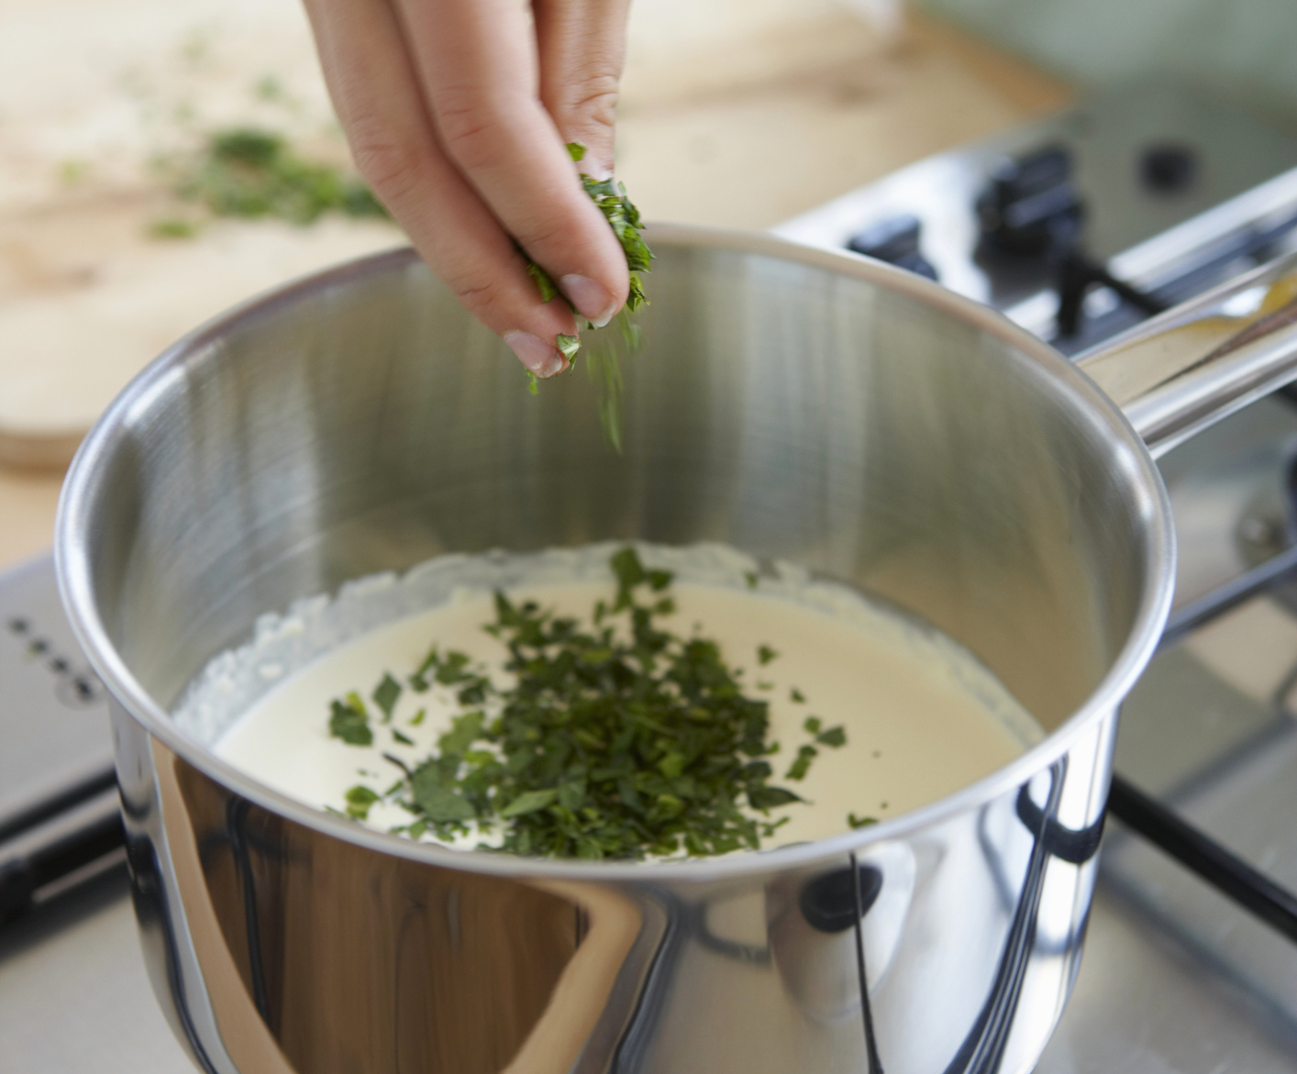
Food Safety Concerns
6
© 2019 Ipsos MRBI
18-084378-Safetrak Research

Slide 7
Food Safety Concerns – Key Take Outs
There are no significant changes in the data versus ST 19 when it comes to being concerned, confused, well informed about or interested in food safety.
Food poisoning and additives/preservatives/E-numbers are the top food related issues of concern at 11% each.
Chicken continues to be the top mentioned food of concern at 72% in ROI and 64% in NI, significantly ahead of all other foods.

Slide 8
Food Related Issue Of Most Concern
Top 5 Issues Of Most Concern
 | ROI
 | (504)
 | %
Additives/ E-numbers/ Dyes/Preservatives | 15 | (+6)
Food poisoning (Salmonella/ Listeria/E.coli) | 11 | (-2)
Hygiene around food | 11 | (+4)
Date marks – Use by date/ Freshness | 9 | (=)
Food not cooked thoroughly/ Un-cooked food | 5 | (-1)
Top 5 Issues Of Most Concern
 | NI
 | (309)
 | %
Chicken - Preparation | 12 | (-6)
Food poisoning (Salmonella/ Listeria/E.coli) | 10 | (-1)
Date marks – Use by date/ Freshness | 8 | (=)
Additives/ E-numbers/ Dyes/Preservatives | 5 | (=)
Handling/ Cross - Contamination | 5 | (+2)
Q.12 What one food related issue are you most concerned about?
Base: All Respondents: 813
() = denotes change vs. Safetrak 18
Notes:
ROI no significant increases since last year in terms of issues of concern, decline in concern around additives. NI Chicken preparation is top concern up 5 percentage points, price of food has entered the top five (was not mentioned last year), this is no surprise given that UK inflation rate reached it’s highest in 6 years in November (3.1%).

Slide 9
Foods Of Most Concern (All Mentions)
ROI
NI
Q.13b Which of these foods if any would you be MOST concerned about when thinking about food safety? And the second most concerned? And the third?
Base: All Respondents: 813
Top 5 mentions shown only
Notes:
Chicken top concern across the board. Ready meals up in ROI (39%). Tesco had spaghetti Bolognese recall in 2017 and Lidl had ready meal recalls. Decline in concerns around shellfish, most notably in NI (Potential reasons?).

Slide 10
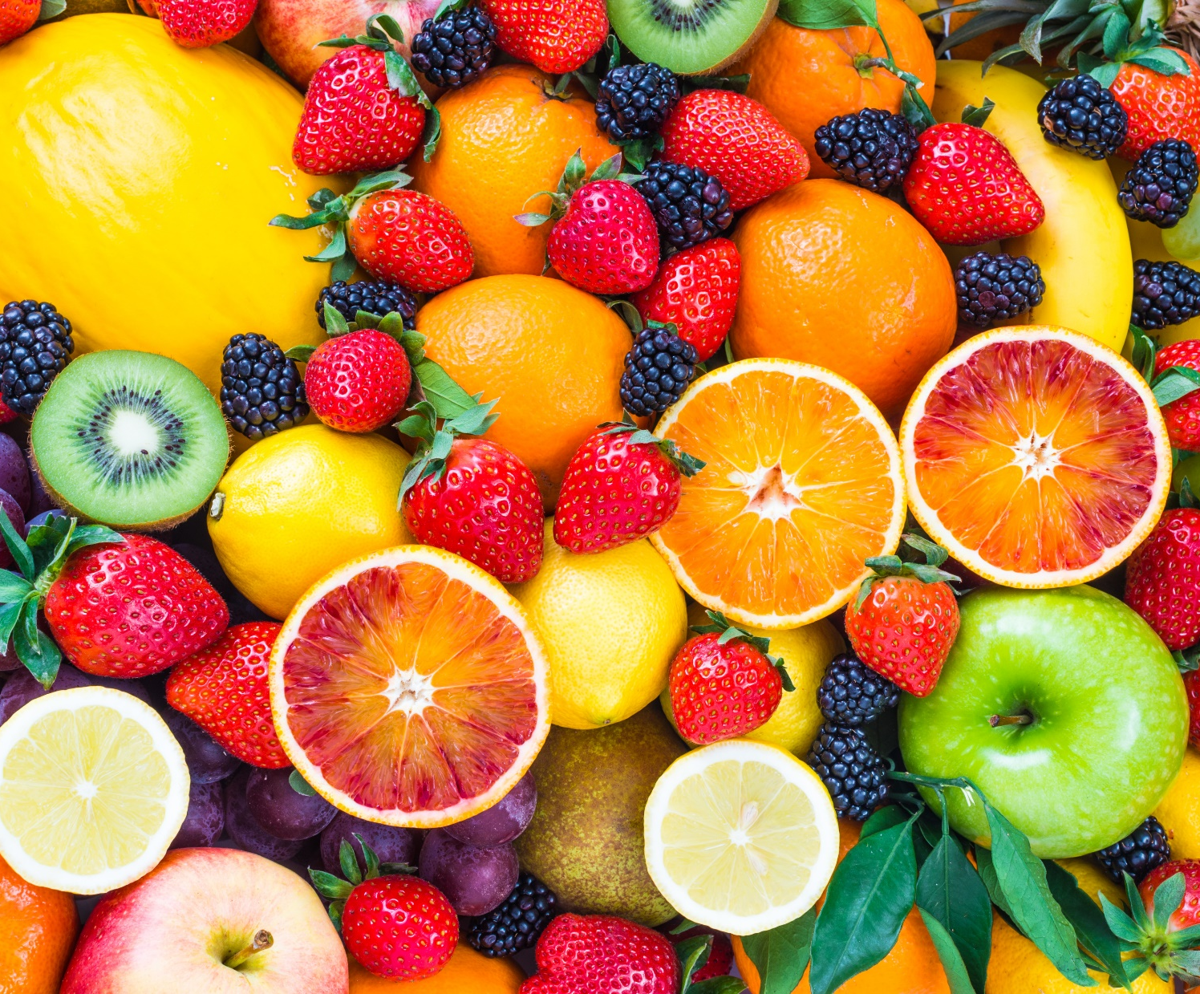
Healthy Eating
10
© 2019 Ipsos MRBI
18-084378-Safetrak Research

Slide 11
Healthy Eating – Key Take Outs
The proportion of adults on the island of Ireland concerned about healthy eating has held steady at 74%, however the proportion who are very concerned has declined by 5 points to 40%. This decline is driven by those living in ROI, where the proportion who are very concerned has declined from 45% to 38%.
30% of ROI respondents claim that they are not well informed about healthy eating, up 5 points since 2017.
Almost one in five (19%) adults in NI claim not to be interested in healthy eating, an increase of 6 points since 2017 and 17% claim to be confused about healthy eating, up 5 points since 2017.

Slide 12
Level Of Agreement With Statements About Healthy Eating – IOI
10=Completely Agree
0 =Completely Disagree
Concerned about
Confused by
Well informed about
Not interested in
9-10
7-8
0-6
Don’t know
Q.18 I’m now going to read out four statements about eating healthily, if you could please tell me how much you agree or disagree with each statement using a scale of 0 to 10. 0 means you completely disagree with the statement and 10 means you completely agree.
Base: All Respondents: 813
Notes:
Marginal movements in terms of feeling well informed and not interested. 26% disagree that they are concerned, up 5 pts (we will do a profile of this before Thursday for mention at this slide). Positively fewer people confused (87%).

Slide 13
Healthy Eating – Main Issue Of Concern*
 | ST 19 | ST 20 | 15-24 | 25-34 | 35-44 | 45-59 | 50-54 | 55-64 | 65-74
 | (808) | (813) | (120) | (153) | (168) | (77) | (73) | (104) | (117)
 | % | % | % | % | % | % | % | % | %
Cholesterol/Blood pressure/Heart disease/Stroke | 14 | 17 | 10 | 14 | 12 | 18 | 25 | 24 | 27
Sugar intake | 12 | 12 | 14 | 15 | 12 | 8 | 8 | 9 | 18
Fats in food/ Fat content/ Saturated fat/ Trans fat | 12 | 13 | 16 | 12 | 15 | 22 | 8 | 9 | 12
Preservatives/Additives/Colouring | 9 | 8 | 6 | 10 | 11 | 5 | 11 | 7 | 5
Weight management | 8 | 5 | 7 | 8 | 6 | 4 | 3 | 4 | -
Cancer | 7 | 7 | 6 | 7 | 9 | 7 | 8 | 3 | 4
Diabetes | 7 | 5 | 5 | 3 | 5 | - | 5 | 6 | 9
Q.19 What one healthy eating issue are you most concerned about? (Unprompted)
Base: All Respondents: 813
*Mentions of 7% or more shown

Slide 14
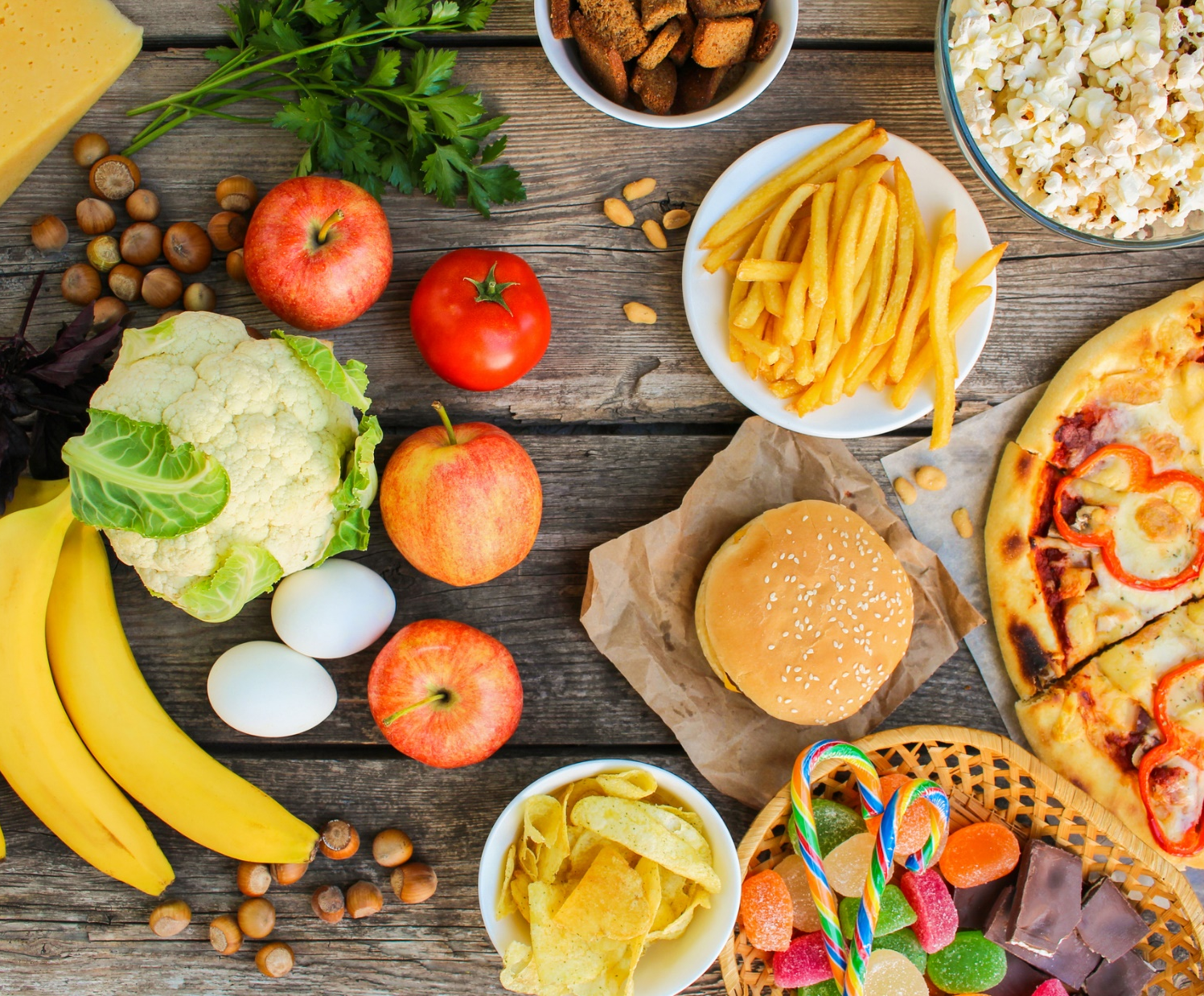
Barriers to Healthy Eating
14
© 2019 Ipsos MRBI
18-084378-Safetrak Research

Slide 15
Barriers to Healthy Eating – Key Take Outs
Just over one third (34%) of adults on the island of Ireland claim to eat out often, rising to 37% in ROI.
The vast majority (81%), believe that there are more special offers for unhealthy foods than there are for healthy foods. This rises to 85% in NI, perhaps going some way to explaining why 57% of NI respondents believe that it is expensive to eat healthily compared to 51% in ROI.

Slide 16
Challenges Facing Households
 | Applies ✓
 | IOI | ROI | NI
 | (813) | (504) | (309)
 | % | % | %
We/I often eat out of the house | 34 | 37 | 30
We/I don’t have enough time to plan & prepare healthy meals | 21 | 20 | 22
We/I do not have enough time to sit down for meals | 15 | 15 | 15
Q.19aa I am now going to read out some statements people have said in relation to the challenges they face for them and their household regarding healthy eating. For each of these statements could you please tell me if they apply, or do not apply to you and your household.
Base: All Respondents: 813

Slide 17
Statements Relating To Healthy Eating
 | Applies ✓
 | IOI | ROI | NI
 | (813) | (504) | (309)
 | % | % | %
There are more special offers for unhealthy foods than there are for healthy foods | 81 | 79 | 85
The amount of advertising for unhealthy food should be restricted | 76 | 78 | 71
Children prefer to eat unhealthy foods rather than healthy foods** | 74 | 75 | 72
The number of fast food outlets should be restricted | 56 | 60 | 49
It is expensive to eat healthily | 53 | 51 | 57
Q.19ab Thinking now about access to different food types, for each of these statements could you please tell me if you agree or disagree with each of the below.
Base: All Respondents: 504 (ROI), 309 (NI) / **All those with children: 250 (ROI), 123 (NI)

Slide 18
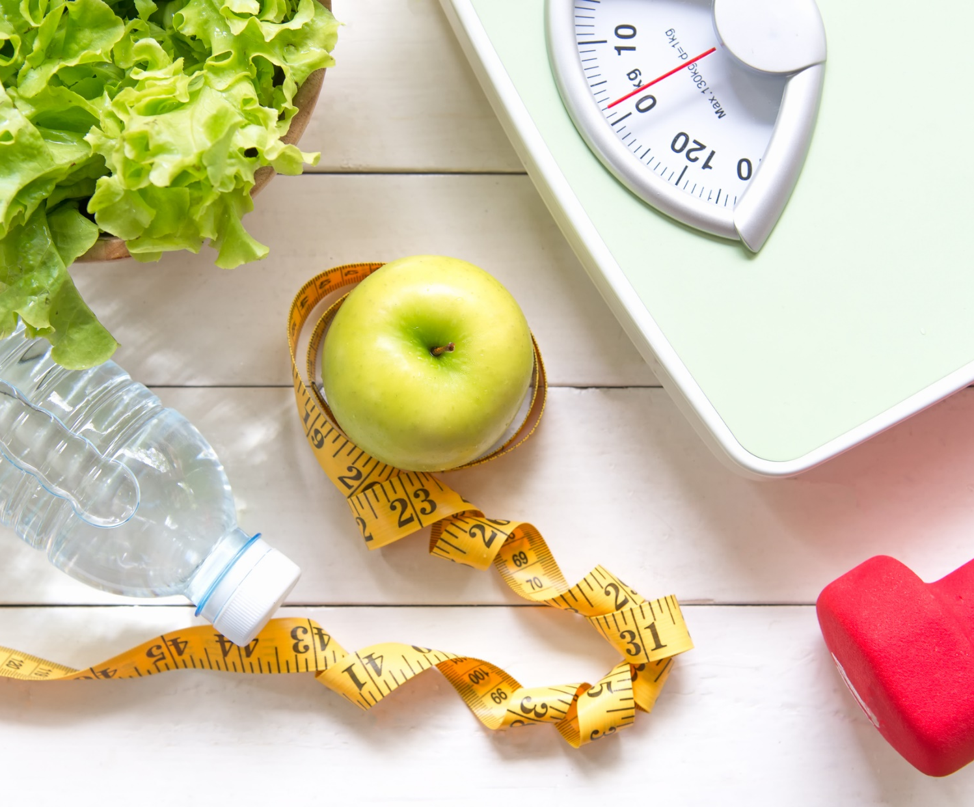
Views on Own Weight
18
© 2019 Ipsos MRBI
18-084378-Safetrak Research

Slide 19
Views on Own Weight – Key Take Outs
The gap between weight perception and weight reality has widened to 23% (from 17%) in ROI. No significant increase was recorded in NI where the gap is 17% (compared to 14% last year).
Just over half (53%) of adults have weighed themselves in the past 3 months and just under one quarter (24%) have checked their BMI. Those living in NI are more likely to check their BMI (31%) than those living in ROI (21%).

Slide 20
Best Description Of Own Weight
IOI | UNDERWEIGHT | ABOUT THE RIGHT WEIGHT | A LITTLE OVERWEIGHT | OVERWEIGHT
ST 19 | 4% | 49% | 34% | 12%
ST 20 | 3% | 54% | 32% | 10%
The increase in the proportion of people who feel that they are about the right weight is driven by those living in ROI (up from 50% to 57%). There are no significant changes in NI perceptions versus ST 20.
Q.19a Which of these statements on this showcard do you feel best describes your weight?
Base: All Respondents: 813

Slide 21
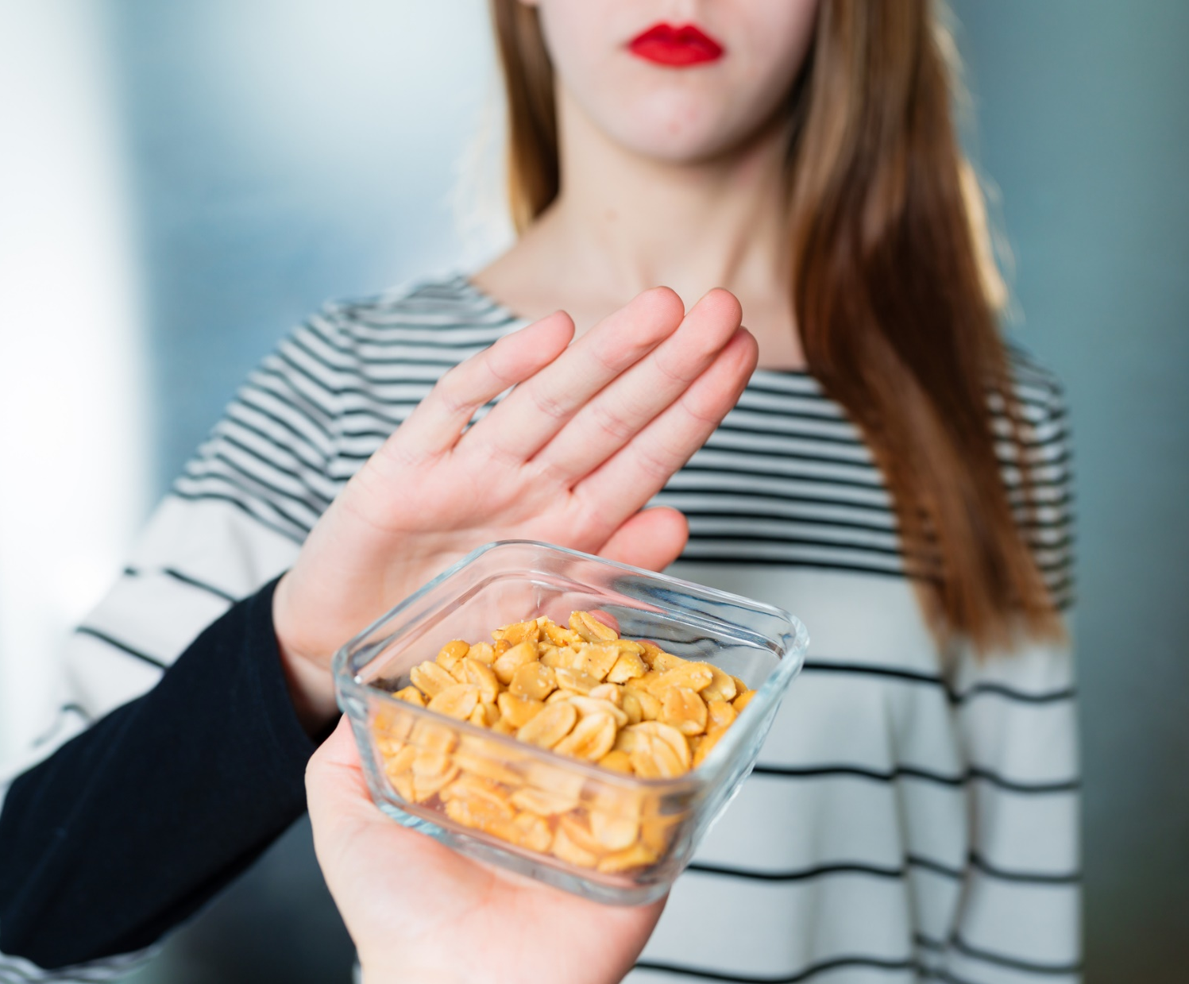
Food Allergies & Intolerances
21
© 2019 Ipsos MRBI
18-084378-Safetrak Research

Slide 22
Food Allergies and Intolerances – Key Take Outs
4% of respondents reported that they personally have a food intolerance and 3% reported that they have an allergy.
Among this group Milk is the number one source of allergy/intolerance at 29%.
The research found that the majority of people never check food labelling for allergen information (58%), never review the ‘may contain’ listing (57%) and never purchase ‘free from’ products (62%).

Slide 23
Incidence Of Food Allergy/Intolerance
Q.51 Do you have any of the following…?
Q.52 Does any other member of your household have any of the following…?
Base: All Respondents: 813

Slide 24
Frequency Of Reviewing Information & Purchasing ‘Free From’ Products
Q.55 And when you do eat outside the home, how often, if at all, do you look at the menu for food allergen information?
Q.56 When purchasing food products in convenience stores/supermarkets, how often, if at all, do you look at the labelling for food allergen information?
Q.57 How often, if at all, do you review food packaging to see if the food product has a ‘may contain’ listed. For example; may contain nuts.
Q.58 How often, if at all, do you buy ‘free from’ food products? By ‘free from’ products we mean food products that do not have allergens such as gluten, nuts, eggs etc.
Base: All Respondents: 813 / All with a food allergy/intolerance and who eat out once a month or more: 44*

Slide 25
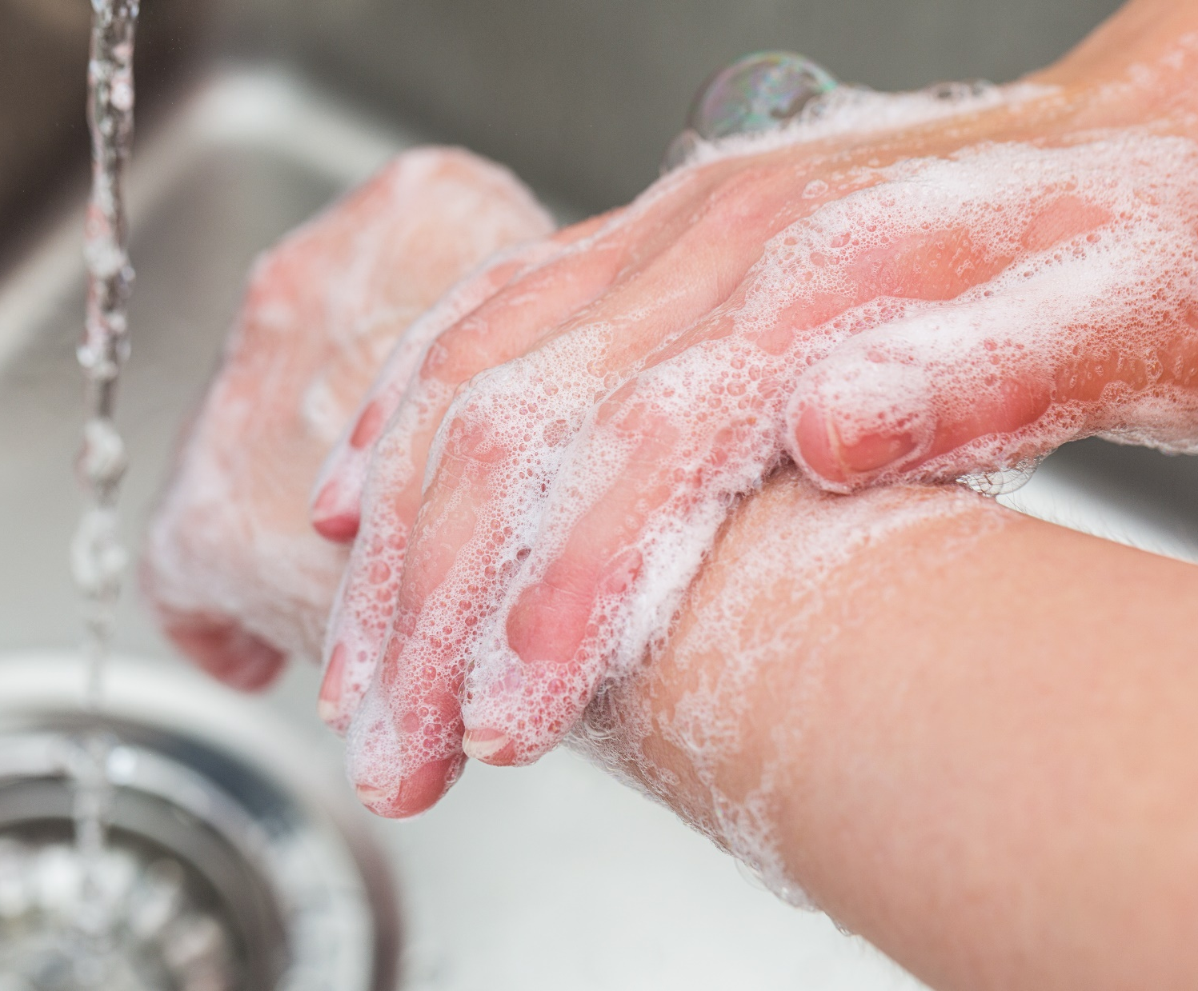
Handwashing
25
© 2019 Ipsos MRBI
18-084378-Safetrak Research

Slide 26
Handwashing – Key Take Outs
93% of adults claim to always wash their hands after using the toilet. The number one reason for not washing hands is because there was no water at 23%.
The vast majority (78%), have used hand sanitisers in the past 3 months with usage among females reaching 84%.
Using soap and water is believed to be the most effective way to wash your hands in all scenarios presented, with the exception of when ‘in the office’ and ‘after shaking hands’.

Slide 27
Length Of Time Washing Hands
Region
Gender
Q.46 Thinking about the time you would typically spend washing your hands, which of the following statements on this showcard would best match the time spent?
Base: All Respondents: 813

Slide 28
Frequency Of Washing Hands – IOI
 | Always | Sometimes | Seldom | Never | Don’t know
 | % | % | % | % | %
After using the toilet | 93 | 5 | 1 | 1 | 1
After handling raw meat | 90 | 5 | 1 | 1 | 2
Before handling cooked meat | 75 | 15 | 4 | 4 | 2
After contact with pets/animals | 68 | 22 | 6 | 3 | 1
Before eating | 51 | 35 | 9 | 5 | *
When you sneeze or blow your nose | 38 | 36 | 18 | 8 | *
When you arrive home | 37 | 35 | 15 | 12 | 1
When you arrive in work | 32 | 21 | 14 | 21 | 12
When you cough | 29 | 34 | 22 | 14 | *
After eating | 28 | 30 | 24 | 17 | *
Q.47 I’m now going to read out some examples of when you may or may not wash your hands. Thinking of a typical day, how often, if at all, would you wash your hands.
Base: All Respondents: 813

Slide 29

Sources of Information On Healthy Eating & Nutrition
29
© 2019 Ipsos MRBI
18-084378-Safetrak Research

Slide 30
Sources of Information – Key Take Outs
Just over one third (35%) of adults on the island of Ireland seek out information about nutrition/healthy eating once per month or more often.
Websites (excluding social media) are cited as the main source of information by 45%, followed by social media at 13% and GP/Doctor at 12%.
As one would expect, the degree to which sources are used varies based on demographic profile.

Slide 31
Frequency Of Seeking Out Nutrition/Healthy Eating Information
Q.60 How often, if at all, would you seek out information about food, nutrition or healthy eating? By this we mean looking up or asking for information on general nutrition, food or healthy eating.
Base: All Respondents: 813

Slide 32
Top 3 Sources of Information x Demographic Profile
 | IOI | Male | Female | 15-24 | 25-34 | 35-44 | 45-49 | 50-54 | 55-64 | 65-74 | ABC1 | C2DEF
 | (240) | (99) | (141) | (32)* | (54) | (53) | (16)* | (24)* | (35)* | (25)* | (118) | (121)
 | % | % | % | % | % | % | % | % | % | % | % | %
Websites (excluding social media) | 45 | 41 | 49 | 45 | 56 | 50 | 51 | 37 | 48 | 9 | 54 | 38
Social Media | 13 | 13 | 13 | 18 | 25 | 10 | 19 | 9 | 2 | - | 12 | 14
GP/Doctor | 12 | 20 | 7 | 10 | 7 | 9 | 18 | 12 | 15 | 25 | 12 | 12
Q.62 And which of these would be your MAIN source of information in relation to food, nutrition or healthy eating?
Base: All who seek out information about nutrition/healthy eating: 240
*Caution: Small Base Size

Slide 33
Contacts
Aisling Corcoran
Director
Rebecca Porter
Associate Director
aisling.corcoran@ipsos.com
rebecca.porter@ipsos.com
+353 1 4389019
+ 353 1 4389041

