Slide 1


Slide 2
Contents
INTRODUCTION
FINDINGS
Food Safety Concerns
Burgers
Healthy Eating
Views on Own Weight
Folic Acid
Childhood Obesity
Food Promotions
Meat Thermometers

Slide 3

INTRODUCTION
3
© 2018 Ipsos MRBI
17-086507-Safetrak Research

Slide 4
Research Methodology
Stratified Random Sample approach.
Interviews conducted face-to-face, in-home, amongst a nationally representative, quota controlled sample of Irish adults.
Data weighted to Census estimates at the analysis stage.
Total number of interviews achieved 808 (507 ROI and 301 NI).
Fieldwork was conducted between November 2017 and January 2018.

Slide 5

FINDINGS
5
© 2018 Ipsos MRBI
17-086507-Safetrak Research

Slide 6
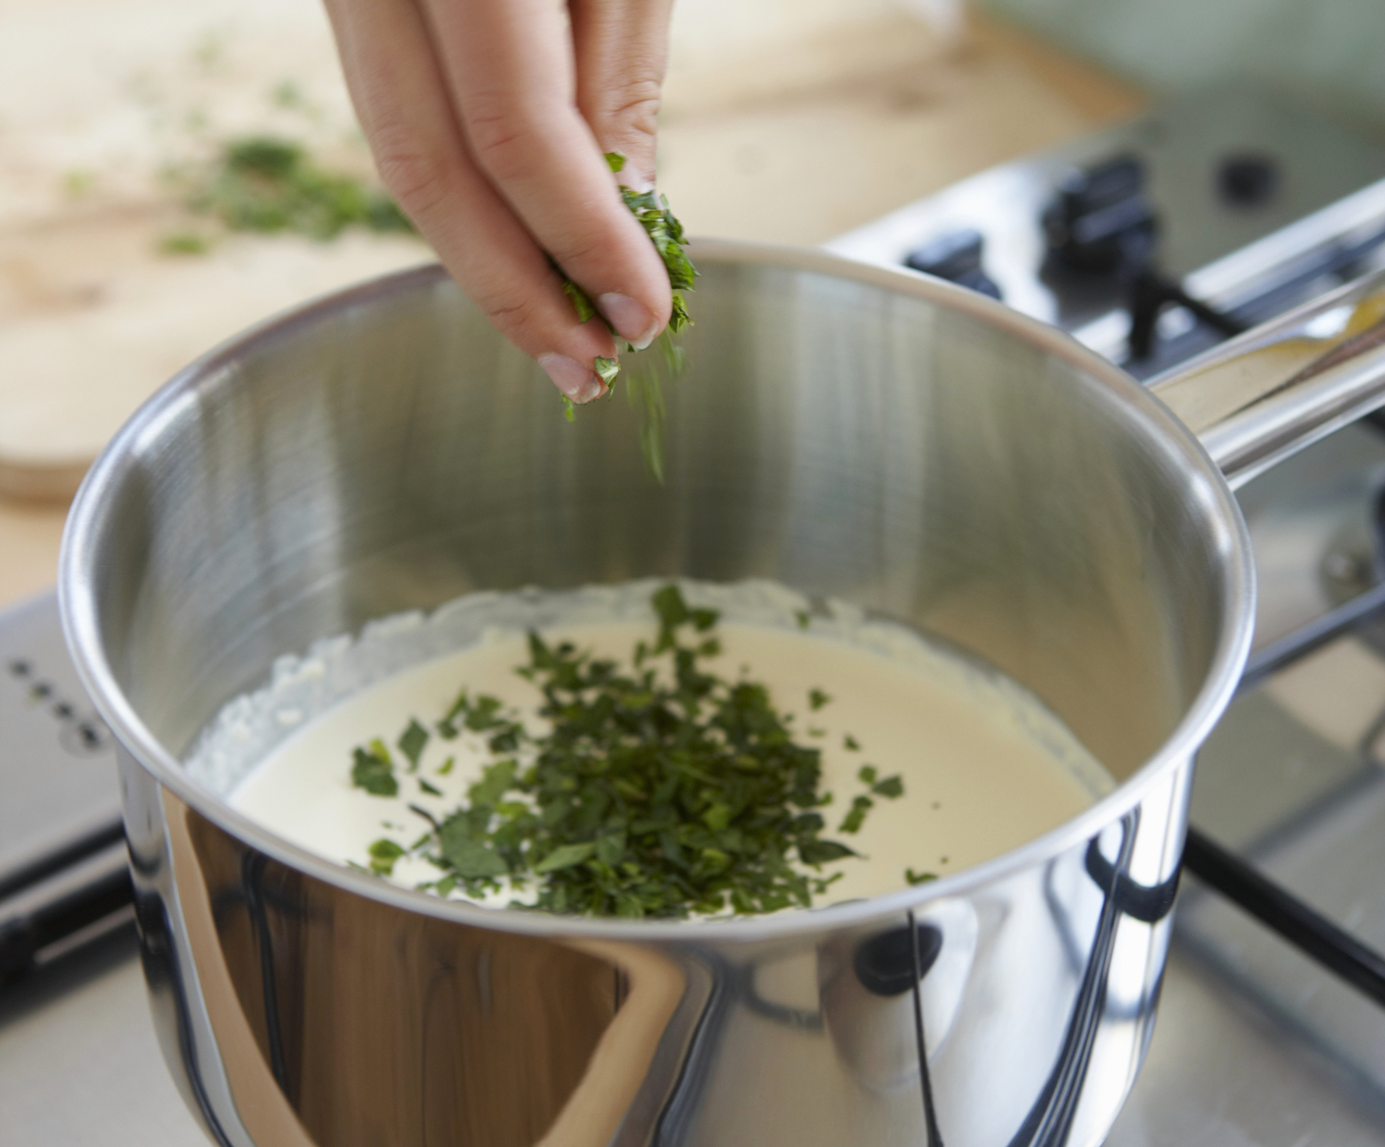
Food Safety Concerns
6
© 2018 Ipsos MRBI
17-086507-Safetrak Research

Slide 7
Level Of Agreement With Statements About Food Safety – IOI
10=Completely Agree
0 =Completely Disagree
Concerned about
Confused by
Well informed about
Not interested in
9-10
7-8
0-6
Don’t know
Q.11 I’m now going to read out four statements about food safety, if you could please tell me how much you agree or disagree with each statement using a scale of 0 to 10. 0 means you completely disagree with the statement and 10 means you completely agree.
Base: All Respondents: 808
Notes:
Concern, confusion and interest have held steady versus last year – no statistically significant shifts. The proportion completely agreeing that they feel well informed about food safety has declined by 5 points with people shifting into the moderately informed 7-8 (we will do analysis on this change ahead of presentation).

Slide 8
Level Of Agreement With Statements About Food Safety – I
10=Completely Agree
0 =Completely Disagree
Concerned about
Confused by
IOI
ROI
NI
IOI
ROI
NI
9-10
7-8
0-6
Don’t know
Q.11 I’m now going to read out four statements about food safety, if you could please tell me how much you agree or disagree with each statement using a scale of 0 to 10. 0 means you completely disagree with the statement and 10 means you completely agree.
Base: All Respondents: 808

Slide 9
Level Of Agreement With Statements About Food Safety – II
10=Completely Agree
0 =Completely Disagree
Well informed about
Not interested in
IOI
ROI
NI
IOI
ROI
NI
9-10
7-8
0-6
Don’t know
Q.11 I’m now going to read out four statements about food safety, if you could please tell me how much you agree or disagree with each statement using a scale of 0 to 10. 0 means you completely disagree with the statement and 10 means you completely agree.
Base: All Respondents: 808

Slide 10
Food Safety Concerns By Demographics (ROI)
(Top 2 Boxes)
 | Total | Male | Female | 15-34 | 35-49 | 50-64 | 65+ | ABC1 | C2DEF
 | (507) | (241) | (266) | (163) | (152) | (114) | (78) | (233) | (273)
 | % | % | % | % | % | % | % | % | %
Concerned about food safety | 48 | 48 | 47 | 50 | 49 | 44 | 44 | 53 | 43
Confused about food safety | 4 | 4 | 4 | 4 | 5 | 3 | 5 | 4 | 5
Well informed about food safety | 33 | 30 | 36 | 33 | 32 | 34 | 33 | 35 | 31
Not interested in food safety | 7 | 6 | 8 | 8 | 5 | 7 | 6 | 7 | 6
Q.11 I’m now going to read out three statements about food safety, if you could please tell me how much you agree or disagree with each statement using a scale of 0 to 10. 0 means you completely disagree with the statement and 10 means you completely agree.
Base: All ROI Respondents: 507

Slide 11
Food Safety Concerns By Demographics (NI)
(Top 2 Boxes)
 | Total | Male | Female | 15-34 | 35-49 | 50-64 | 65+ | ABC1 | C2DE
 | (301) | (145) | (156) | (101) | (73) | (71) | (56) | (136) | (160)
 | % | % | % | % | % | % | % | % | %
Concerned about food safety | 50 | 46 | 54 | 45 | 56 | 54 | 47 | 55 | 48
Confused about food safety | 1 | 2 | * | 1 | 1 | - | 3 | * | 2
Well informed about food safety | 42 | 35 | 49 | 39 | 48 | 49 | 28 | 44 | 42
Not interested in food safety | 6 | 5 | 6 | 9 | 2 | 7 | 2 | 4 | 7
Q.11 I’m now going to read out three statements about food safety, if you could please tell me how much you agree or disagree with each statement using a scale of 0 to 10. 0 means you completely disagree with the statement and 10 means you completely agree.
Base: All NI Respondents: 301

Slide 12
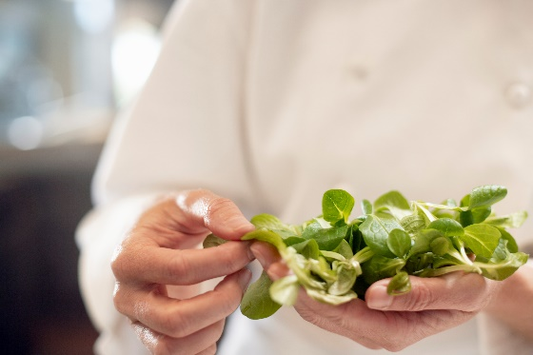
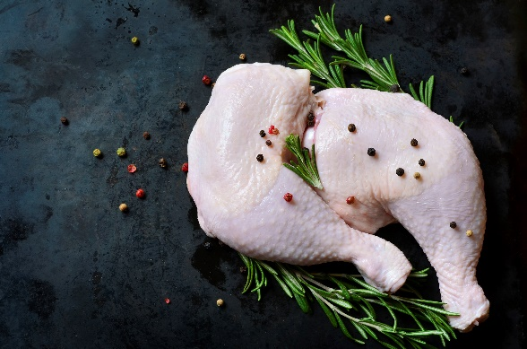
Food Related Issue Of Most Concern - I
 | ST 18 (805) % | ST 19 (808) %
Food poisoning (Salmonella/ Listeria/ E.coli) | 13 | 12
Chicken - Preparation | 9 | 12
Date marks – Best before date/ Use by date/ Freshness | 8 | 9
Additives/ E-numbers/ Dyes/Preservatives | 10 | 8
Hygiene around food | 8 | 6
Food not cooked thoroughly/ Un-cooked food | 6 | 6
No concerns | 5 | 6
Handling/ Cross - Contamination | 6 | 5
Country of origin/ Foreign goods/ Ensure it's Irish | 3 | 4
Sugar content | 4 | 3
Price of food | 1 | 3
Fat content/ Fatty acids/ Saturated fat | 4 | 3
Red meat/BSE/ Brazilian beef | 2 | 3
Hygiene in your kitchen | 1 | 3
Pesticides | 3 | 2
Ensuring balanced/ Healthy diet | 2 | 2
Food storage | 1 | 2
Pork – Preparation | 2 | 2
Salt content | 2 | 2
Salmonella/Eggs | 1 | 2
Genetically Modified Foods | 2 | 1
Pollution | 1 | 1
Information on food packaging | n/a | 1
Processed food | n/a | n/a
Other | 4 | 3
Don't know | 1 | -
Q.12 What one food related issue are you most concerned about?
Base: All Respondents: 808

Slide 13
Food Related Issue Of Most Concern - II
Top 5 Issues Of Most Concern
 | ROI
 | (507)
 | %
Food poisoning (Salmonella/ Listeria/E.coli) | 13% | (+1)
Additives/ E-numbers/ Dyes/Preservatives | 9% | (-4)
Date marks – Use by date/Freshness | 9% | (=)
Chicken - Preparation | 8% | (+1)
Hygiene around food | 7% | (-2)
Top 5 Issues Of Most Concern
 | NI
 | (301)
 | %
Chicken - Preparation | 18% | (+5)
Food poisoning (Salmonella/ Listeria/E.coli) | 11% | (-3)
Date marks – Use by date/ Freshness | 8% | (=)
Price of food | 6% | (+6)
Food not cooked thoroughly/ Un-cooked food | 6% | (+2)
Q.12 What one food related issue are you most concerned about?
Base: All Respondents: 808
() = denotes change vs. Safetrak 18
Notes:
ROI no significant increases since last year in terms of issues of concern, decline in concern around additives. NI Chicken preparation is top concern up 5 percentage points, price of food has entered the top five (was not mentioned last year), this is no surprise given that UK inflation rate reached it’s highest in 6 years in November (3.1%).

Slide 14
Foods Of Most Concern (1st Mention Trended)
 | ST 17 | ST 18 | ST 19
 | (805) | (805) | (808)
 | % | % | %
Chicken/poultry | 39 | 41 | 43
Shellfish | 13 | 12 | 7
Ready-made meals | 6 | 10 | 6
Fish | 5 | 5 | 8
Frozen foods | 4 | 5 | 2
Eggs | 10 | 3 | 4
Cooked rice/pasta | 1 | 2 | 1
Dairy products (e.g. milk yoghurt) | 3 | 2 | 2
Duck eggs | 1 | * | 1
Berries | 1 | * | *
Pork | - | * | 1
Raw steak | n/a | n/a | 4
Raw mince meat | n/a | n/a | 11
Other | 1 | 1 | 2
Do not have concern about any of these foods | 3 | 7 | 9
Q.13b Which of these foods if any would you be MOST concerned about when thinking about food safety? And the second most concerned? And the third?
Base: All Respondents: 808

Slide 15
Foods Of Most Concern (All Mentions)
 | ST 18 |  |  | ST 19
 | IOI | ROI | NI | IOI | ROI | NI
 | (805) | (504) | (301) | (808) | (507) | (301)
 | % | % | % | % | % | %
Chicken/poultry | 70 | 69 | 71 | 68 | 71 | 64
Raw mince meat | n/a | n/a | n/a | 35 | 42 | 23
Shellfish | 35 | 33 | 37 | 26 | 29 | 20
Fish | 26 | 29 | 22 | 25 | 29 | 19
Ready-made meals | 28 | 31 | 23 | 23 | 39 | 14
Eggs | 23 | 22 | 26 | 21 | 20 | 23
Raw steak | n/a | n/a | n/a | 17 | 18 | 16
Frozen foods | 17 | 20 | 13 | 12 | 16 | 6
Dairy products (e.g. milk, yoghurt) | 14 | 10 | 21 | 10 | 10 | 10
Cooked rice/pasta | 10 | 8 | 12 | 7 | 5 | 10
Pork | 1 | 2 | 1 | 4 | 3 | 4
Duck eggs | 4 | 3 | 4 | 3 | 3 | 2
Berries | 1 | 2 | - | 1 | 2 | 1
Other | 1 | 1 | 1 | - | - | -
Do not have concern about any of these foods | 7 | 7 | 7 | 19 | 8 | 37
Q.13b Which of these foods if any would you be MOST concerned about when thinking about food safety? And the second most concerned? And the third?
Base: All Respondents: 808
n/a – not asked in ST 18
Notes:
Chicken top concern across the board. Ready meals up in ROI (39%). Tesco had spaghetti Bolognese recall in 2017 and Lidl had ready meal recalls. Decline in concerns around shellfish, most notably in NI (Potential reasons?).

Slide 16
Foods Of Most Concern (Unprompted)
 | IOI | ROI | NI
 | (808) | (507) | (301)
 | % | % | %
Chicken/poultry | 36 | 39 | 31
All meats | 14 | 15 | 12
Fish | 9 | 12 | 3
Pork/ham | 6 | 7 | 5
Eggs | 4 | 5 | 2
Food that would cause food poisoning | 4 | 4 | 4
Properly cooked/prepared food | 3 | 2 | 5
Raw meat | 3 | 3 | 2
Other food | 3 | 3 | 2
Out of date food/that it's fresh | 3 | 3 | 3
Other | 5 | 4 | 7
None/not concerned about any food | 8 | 3 | 17
Q.13a Which foods, if any, would you be MOST concerned about when thinking about food safety?
Base: All Respondents: 808
* Others 2% or less of total not shown

Slide 17
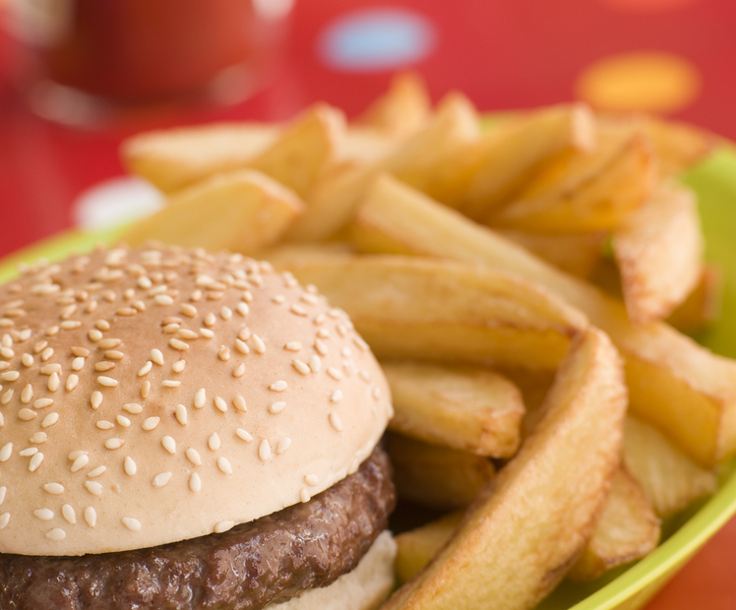
Burgers
17
© 2018 Ipsos MRBI
17-086507-Safetrak Research

Slide 18
The rise of the burger from a scapegoat for the obesity crisis to the symbol of a dining revolution was fuelled by a combination of social media and recession-era economics, and it established a whole new class of restaurant: inspired by simple street food, led by untrained chefs and advertised via Twitter.
The Guardian Life & Style, November 2017

Slide 19
Preference For How Burger Is Cooked When Dining Out – ST 18
Rare
Medium Rare
Medium
Medium Well
Well done
Do not eat burgers
*
Q.15 When dining out, what is your preference for how your burger is cooked?
Base: All Respondents: 805

Slide 20
Those who Eat Burgers x Preference When Dining Out – ST 18
IOI
ROI
NI
Rare
Medium rare
Medium
Medium well
Well done
Q.15 When dining out, what is your preference for how your burger is cooked?
Base: All Respondents who eat burgers: 716

Slide 21
Preference For How Burger Is Cooked When Dining Out – ST 19
IOI
ROI
NI
Rare
Medium rare
Medium
Medium well
Well done
Do not eat burgers
Q.15 When dining out, what is your preference for how your beef burger is cooked?
Base: All Respondents: 808

Slide 22
Those who Eat Burgers x Preference When Dining Out – ST 19
IOI
ROI
NI
Rare
Medium rare
Medium
Medium well
Well done
Q.15 When dining out, what is your preference for how your beef burger is cooked?
Base: All Respondents who eat burgers: 664

Slide 23
Those who Eat Burgers x Preference When Dining Out
IOI
ROI
NI
IOI
ROI
NI
Rare
Medium rare
Medium
Medium well
Well done
Rare
Medium rare
Medium
Medium well
Well done
Q.15 When dining out, what is your preference for how your burger is cooked?
Base: All Respondents who eat burgers: 716
Q.15 When dining out, what is your preference for how your beef burger is cooked?
Base: All Respondents who eat beef burgers: 664
Notes:
Marginal decline in well done in ROI, Increase in NI. Note slight difference in question wording. Reference safefood did own research on campaign outcome directly after the campaign.

Slide 24
Preference For How Burger Is Cooked When Dining Out by Age
 | ST 19 | 15-24 | 25-34 | 35-44 | 45-49 | 50-64 | 65-74
 | (808) | (102) | (162) | (155) | (70) | (84) | (134)
 | % | % | % | % | % | % | %
Rare | 1 | 1 | 1 | 2 | 2 | 3 | -
Medium rare | 4 | 8 | 5 | 4 | 1 | 4 | 1
Medium | 8 | 12 | 10 | 7 | 7 | 3 | 4
Medium well | 10 | 13 | 11 | 9 | 10 | 13 | 7
Well done | 61 | 56 | 59 | 66 | 65 | 66 | 50
Do not eat burgers | 17 | 11 | 14 | 12 | 15 | 12 | 38
Q.15 When dining out, what is your preference for how your beef burger is cooked?
Base: All Respondents: 808

Slide 25
Those who Eat Burgers – Cooking Preference by Age
 | ST 19 | 15-24 | 25-34 | 35-44 | 45-49 | 50-64 | 65-74
 | (664) | (92) | (141) | (134) | (59) | (153) | (85)
 | % | % | % | % | % | % | %
Rare | 1 | 1 | 2 | 2 | 2 | 2 | -
Medium rare | 5 | 9 | 6 | 5 | 1 | 3 | 2
Medium | 9 | 13 | 12 | 7 | 8 | 7 | 6
Medium well | 12 | 15 | 13 | 10 | 12 | 11 | 12
Well done | 73 | 63 | 68 | 76 | 76 | 78 | 80
Q.15 When dining out, what is your preference for how your beef burger is cooked?
Base: All Respondents who eat burgers: 664

Slide 26
Profile of Those who Consume Burgers that are Not Well Done
Just under half (47%) are aged 15-34 years.
Significantly more likely to be male (64%) than female (36%).
Slightly more ABC1s (54%) than C2DEs (46%) are consuming burgers that are not well done.
43% of ROI consumers of these burgers are based in Dublin.
Q.15 When dining out, what is your preference for how your beef burger is cooked?
Base: All Respondents who prefer rare, medium, medium-well done burgers: 178

Slide 27
Reason For Cooking Preference – ST 18
 | Total | Rare | Medium Rare | Medium | Medium Well
 | (195) | (5)* | (31)* | (59) | (100)
 |  | % | % | % | %
Tastier burger | 44 | 42 | 53 | 47 | 39
Juicer burger | 23 | - | 21 | 21 | 25
I like having a choice of rare or medium | 11 | - | 16 | 13 | 8
Trust the restaurant | 10 | 22 | 6 | 7 | 13
Confident about the food preparation | 10 | 22 | - | 9 | 13
Trust the source of the meat | 6 | 22 | 9 | 7 | 4
Eaten at the restaurant before | 4 | - | - | 5 | 5
Properly cooked | 3 | - | - | 1 | 4
Personal preference | 1 | - | 3 | - | 2
Other | 6 | 36 | - | 10 | 4
No Reasons | 1 | - | - | - | 1
Don’t know | 2 | - | 3 | - | 4
Q.16 What are the reasons, if any, for choosing to have a rare or medium burger when dining out?
Base: All who do not eat well done burgers: 195
*Caution: Small Base Size

Slide 28
Reason For Cooking Preference – ST 19
 | ST 19 | Rare | Medium Rare | Medium | Medium Well
 | (178) | (8*) | (29*) | (59) | (82)
 | % | % | % | % | %
Tastier burger | 49 | 75 | 69 | 53 | 35
Confident about the food preparation | 19 | 12 | 9 | 13 | 27
Juicer burger | 18 | 9 | 5 | 29 | 16
I like having a choice of rare or medium | 13 | - | 20 | 10 | 14
Eaten at the restaurant before | 13 | 16 | 5 | 13 | 15
Trust the restaurant | 12 | - | 7 | 13 | 14
Trust the source of the meat | 6 | 12 | 10 | 3 | 5
Properly cooked | 2 | - | - | 1 | 3
Personal preference | * | - | - | - | 1
Other | 4 | - | 3 | 3 | 6
No Reasons | 1 | - | - | - | 2
Don’t know | 1 | - | - | 2 | -
Q.16 What are the reasons, if any, for choosing to have a <<insert burger preference>> when dining out?
Base: All who do not eat well done burgers: 178
*Caution: Small Base Size

Slide 29
Rare or Medium Burgers – Safe To Eat Or
Not? – ST 19
Burger Preference
Safe
Not safe
Don’t know
Q.17a Do you think that rare or medium burgers are safe to eat, or are they not safe to eat?**
Base: All Respondents: 808
*Caution: Small Base Size
**Question text updated for ST 19 to include rare or medium burgers vs rare only in ST 18

Slide 30
Rare Burgers – Safe To Eat Or Not? – ST 18
Burger Preference
Safe
Not safe
Don’t know
Q.17 Do you think that rare burgers are safe to eat, or are they not safe to eat?
Base: All Respondents: 805
*Caution: Small Base Size

Slide 31
Change In Preference In How Beef Burger Is Cooked
Q.17b In the last year, have you changed your preference for how your beef burger is cooked?
Base: All Respondents: 664

Slide 32
Cooking Preference Changes
Q.17c How do you order your beef burger now?
Base: All who changed cooking preference in past year: 30*

Slide 33
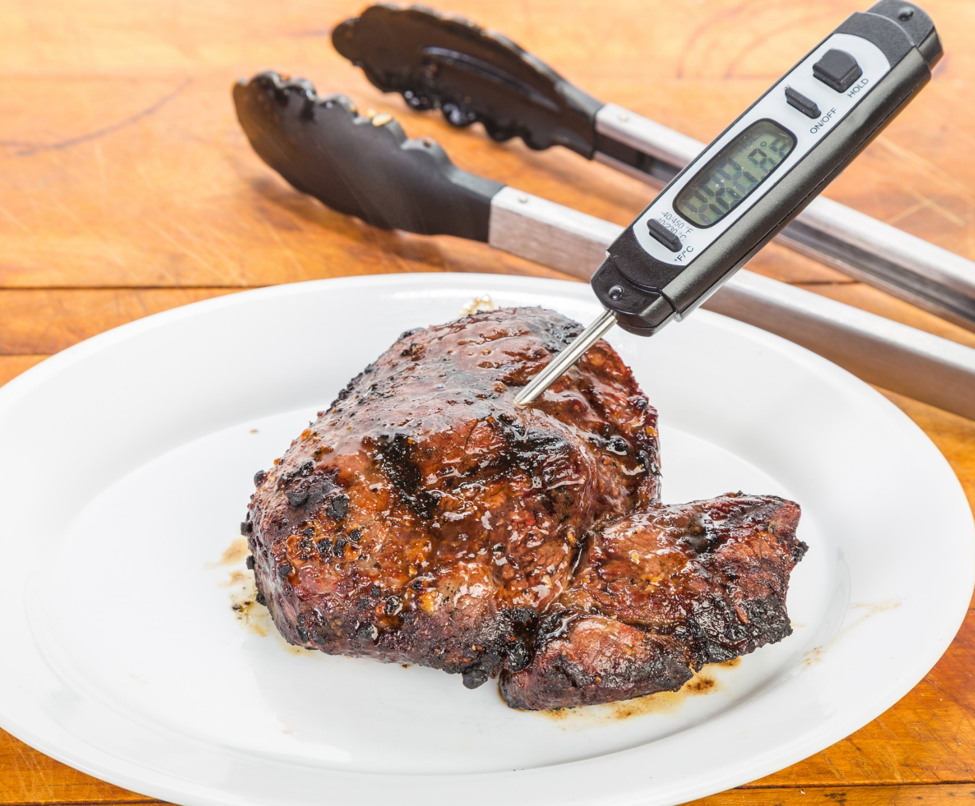
Meat Thermometers
33
© 2018 Ipsos MRBI
17-086507-Safetrak Research

Slide 34
Meat Cooked All The Way Through
 | ST 19
 | IOI | ROI | NI
 | (701) | (440) | (261)
 | % | % | %
Make sure there is no pink meat | 50 | 48 | 53
When the juices from the thickest part of the meat run clear | 40 | 45 | 31
Check the meat is piping hot all the way through | 19 | 18 | 20
Use a meat thermometer | 14 | 13 | 16
Don’t ever cook meat | 3 | 2 | 4
By the colour of it/looking at it | 2 | 1 | 3
Cook it for long enough/time | 2 | 2 | 1
Others 1% or less of total not shown
Q.36 How do you know if meat is cooked all the way through?
Base: All respondents involved in food preparation: 701

Slide 35
Ownership & Use Of Meat Thermometer
Ownership
Use
ROI 21%
NI 22%
ROI 84%
NI 86%
Q.37 Do you have a meat thermometer?
Q.38 Do you ever use the meat thermometer?
Base: All involved in food preparation/all who have a meat thermometer: 701/149

Slide 36
Profile of Meat Thermometer Owners
Highest level of ownership is in the 25-44 year old category (42%), the lowest level is amongst 65-74 at 9%.
Meat thermometer owners have above average levels of awareness of safefood (88%).
ABC1s are significantly more likely to own a meat thermometer (57%) than C2DEF (43%).
There are no significant differences in the profile of those who own a meat thermometer and those who actually use it.
Q.37 Do you have a meat thermometer?
Base: All Respondents who have a meat thermometer: 149

Slide 37
Cuts Of Meat Usually Use A Meat Thermometer On
 | ST 19
 | IOI | ROI | NI
 | (125) | (76) | (49)
 | Yes | Yes | Yes
 | % | % | %
Turkey | 89 | 90 | 87
Roast of beef | 83 | 85 | 80
Roast of lamb | 69 | 80 | 53
Chicken | 78 | 74 | 85
Roast ham | 68 | 69 | 67
Beef burger | 40 | 39 | 41
Steaks | 42 | 39 | 48
Chicken burgers | 37 | 35 | 41
Sausages | 29 | 25 | 35
Pork* | 8 | 12 | 2
Any other meat | 7 | 9 | 3
Q.39 What cuts of meat would you usually use a meat thermometer on?
Base: All respondents who use a meat thermometer
*Pork unprompted, all other meats prompted

Slide 38
Reasons For Not Using A Meat Thermometer
ROI | NI
(16*) | (8*)
% | %
37 | 12
- | 57
16 | 14
16 | -
7 | -
14 | 17
7 | -
Q.40 Is there any reason you don’t use your meat thermometer?
Base: All respondents who own a meat thermometer but do not use it: 24*
* Caution small base size

Slide 39
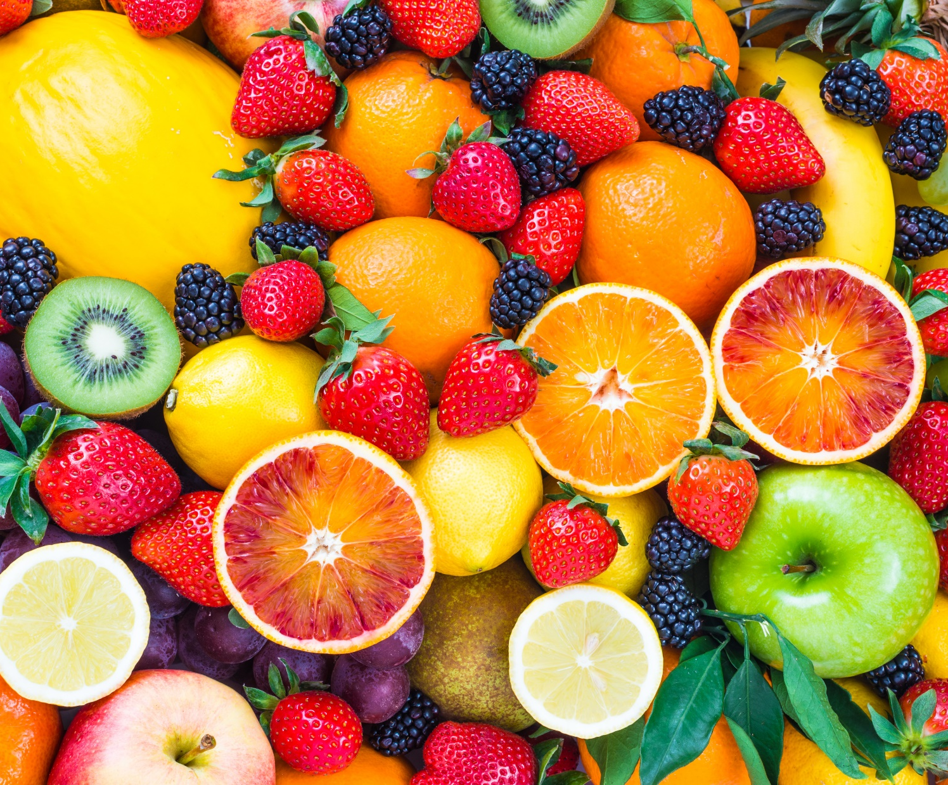
Healthy Eating
39
© 2018 Ipsos MRBI
17-086507-Safetrak Research

Slide 40
Level Of Agreement With Statements About Healthy Eating – IOI
10=Completely Agree
0 =Completely Disagree
Concerned about
Confused by
Well informed about
Not interested in
9-10
7-8
0-6
Don’t know
Q.18 I’m now going to read out four statements about eating healthily, if you could please tell me how much you agree or disagree with each statement using a scale of 0 to 10. 0 means you completely disagree with the statement and 10 means you completely agree.
Base: All Respondents: 808
Notes:
Marginal movements in terms of feeling well informed and not interested. 26% disagree that they are concerned, up 5 pts (we will do a profile of this before Thursday for mention at this slide). Positively fewer people confused (87%).

Slide 41
Level Of Agreement With Statements About Healthy Eating – I
10=Completely Agree
0 =Completely Disagree
Concerned about
Confused by
IOI
ROI
NI
IOI
ROI
NI
9-10
7-8
0-6
Don’t know
Q.18 I’m now going to read out four statements about eating healthily, if you could please tell me how much you agree or disagree with each statement using a scale of 0 to 10. 0 means you completely disagree with the statement and 10 means you completely agree.
Base: All Respondents: 808

Slide 42
Level Of Agreement With Statements About Healthy Eating – II
10=Completely Agree
0 =Completely Disagree
Well informed about
Not interested in
IOI
ROI
NI
IOI
ROI
NI
9-10
7-8
0-6
Don’t know
Q.18 I’m now going to read out four statements about eating healthily, if you could please tell me how much you agree or disagree with each statement using a scale of 0 to 10. 0 means you completely disagree with the statement and 10 means you completely agree.
Base: All Respondents: 808

Slide 43
Healthy Eating – Main Issue Of Concern
 | ST 18 |  |  | ST 19
 | IOI | ROI | NI | IOI | ROI | NI
 | (805) | (504) | (301) | (808) | (507) | (301)
 | % | % | % | % | % | %
Cholesterol/Blood pressure/Heart disease/Stroke | 21 | 23 | 17 | 14 | 18 | 9
Fats in food/ Fat content/ Saturated fat/ Trans fat | 14 | 16 | 12 | 12 | 12 | 12
Sugar intake | 12 | 11 | 14 | 12 | 13 | 10
Weight management | 8 | 6 | 12 | 8 | 6 | 11
Preservatives/Additives/Colouring | 7 | 9 | 3 | 9 | 10 | 7
Cancer | 7 | 7 | 6 | 7 | 9 | 4
Diabetes | 5 | 5 | 4 | 7 | 6 | 8
Salt | 4 | 2 | 7 | 5 | 5 | 6
Variety in diet | 2 | 3 | 1 | 3 | 3 | 2
Food for children | 2 | 3 | 2 | 4 | 4 | 3
Getting the 5-a-day | 2 | 1 | 3 | 1 | 2 | 1
Fruit/Veg | 2 | 2 | 2 | 1 | 1 | 1
Vitamins and minerals | 1 | 1 | * | 1 | * | 2
The expense of eating healthily | * | 1 | - | * | - | *
Fibre | * | * | * | * | * | *
Wholegrain | * | - | 1 | * | * | 1
Eating healthily during pregnancy | * | * | - | * | * | 1
None | 6 | 5 | 6 | 6 | 1 | 13
Other | 4 | 3 | 5 | 3 | 3 | 2
Don’t know/ can’t remember | 2 | 3 | 2 | 3 | 2 | 4
Q.19 What one healthy eating issue are you most concerned about? (Unprompted)
Base: All Respondents: 808

Slide 44
Healthy Eating – Main Issue Of Concern*
 | ST 18 | ST 19 | 15-24 | 25-34 | 35-44 | 45-59 | 50-54 | 55-64 | 65-74
 | (805) | (808) | (137) | (162) | (155) | (70) | (84) | (101) | (134)
 | % | % | % | % | % | % | % | % | %
Cholesterol/Blood pressure/Heart disease/Stroke | 21 | 14 | 9 | 8 | 14 | 15 | 12 | 26 | 25
Sugar intake | 12 | 12 | 16 | 10 | 15 | 22 | 12 | 6 | 6
Fats in food/ Fat content/ Saturated fat/ Trans fat | 14 | 12 | 11 | 14 | 12 | 12 | 16 | 11 | 7
Preservatives/Additives/Colouring | 7 | 9 | 10 | 12 | 11 | 1 | 7 | 7 | 9
Weight management | 8 | 8 | 13 | 10 | 6 | 7 | 12 | 3 | 3
Cancer | 7 | 7 | 4 | 5 | 8 | 2 | 12 | 12 | 9
Diabetes | 5 | 7 | 7 | 4 | 8 | 10 | 6 | 3 | 10
Q.19 What one healthy eating issue are you most concerned about? (Unprompted)
Base: All Respondents: 808
*Mentions of 7% or more shown

Slide 45
Healthy Eating – Issue of Most Concern
(Trended)
Cholesterol/Blood pressure/Heart disease/Stroke
Fats in food/ Fat content/ Saturated fat/ Trans fat
Diabetes
Preservatives/Additives/Colouring
Sugar intake
Salt
Cancer
Variety in diet
Weight management
Food for children
Fruit/Veg
Getting the 5-a-day
Fibre
Vitamins and minerals
Wholegrain
Eating healthily during pregnancy
Expense of eating healthy
Other
None
Don’t know/ can’t remember
Q.19 What one healthy eating issue are you most concerned about? (Unprompted)
Base: All Respondents: 808
Notes:
Cholesterol etc. still top but down, focus has shifted away from this towards behaviours and attitudes in recent years. Sugar and weight management holding steady.

Slide 46
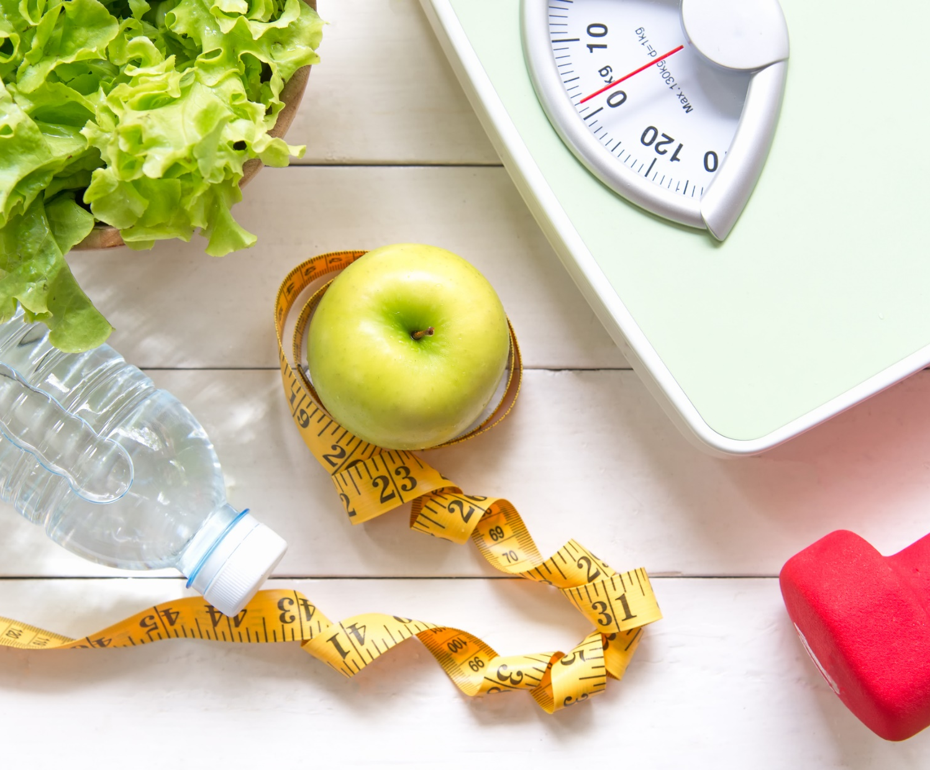
Views on Own Weight
46
© 2018 Ipsos MRBI
17-086507-Safetrak Research

Slide 47
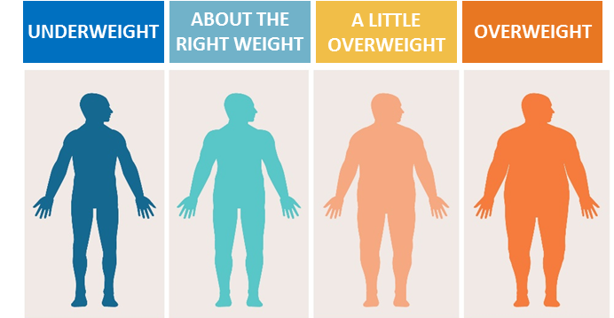
Best Description On Own Weight
IOI
(808)
%
ROI
(507)
%
NI
(301)
%
4%
49%
34%
12%
4%
50%
34%
11%
4%
48%
35%
14%
Q.19a Which of these statements on this showcard do you feel best describes your weight?
Base: All Respondents: 808

Slide 48
Our Weight Perception Versus Reality
IOI
(808)
%
Perception
54%
46%
Reality
38%
62%
Q.19a Which of these statements on this showcard do you feel best describes your weight?
Base: All Respondents: 808

Slide 49
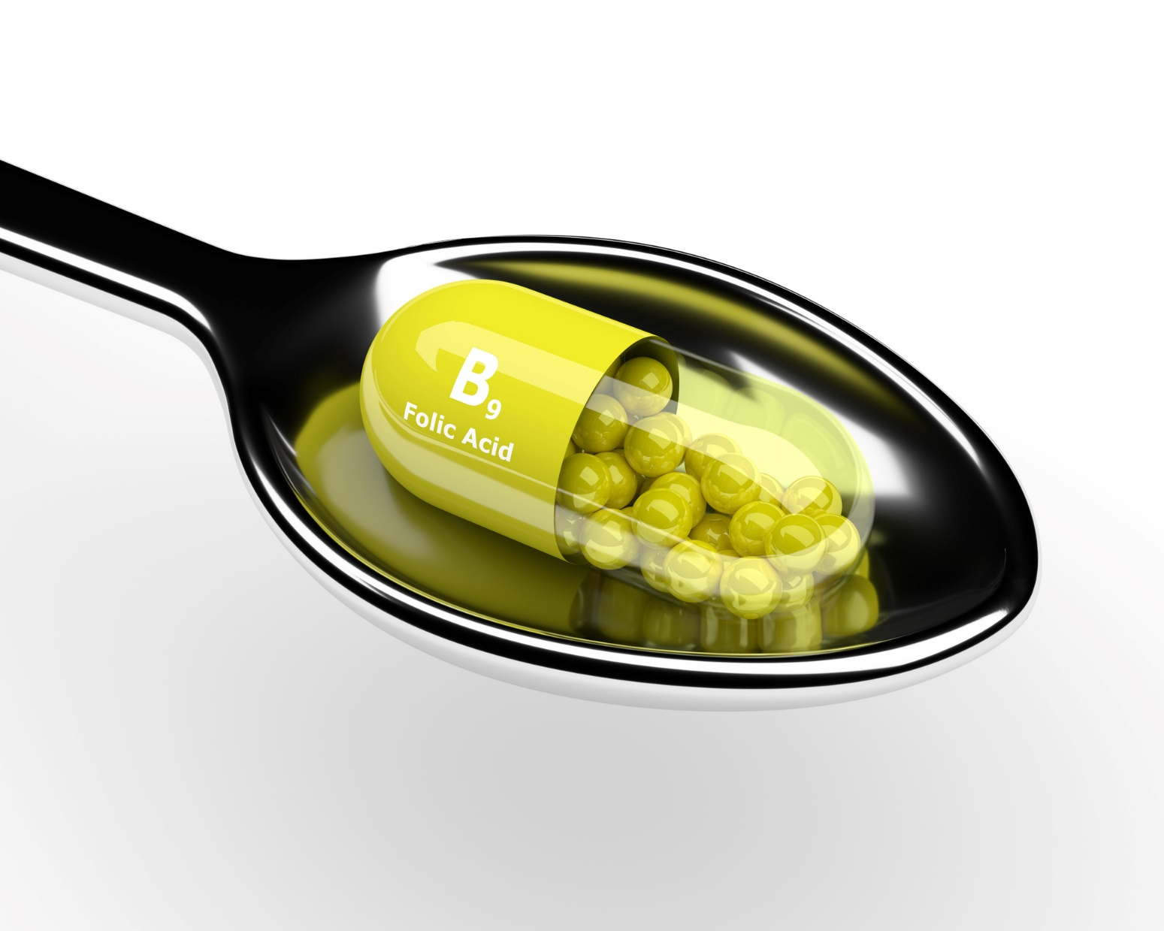
Folic Acid
49
© 2018 Ipsos MRBI
17-086507-Safetrak Research

Slide 50
Currently Taking Folic Acid
Q.31 Are you currently taking folic acid?
Base: All females aged 18-49: 264

Slide 51
Reasons For Taking Folic Acid
ROI 51%
NI 62%
Q.32 Which of the following statements was closest to your own situation?
Base: All currently taking folic acid: 30*
* Caution small base size

Slide 52

Food Promotions
52
© 2018 Ipsos MRBI
17-086507-Safetrak Research

Slide 53
Evidence of Imbalance in Food Promotions
Of 77,165 promotions where nutritional data was available…..
34% of vegetables
30% of fresh fruit
69% of soft drinks
52% of confectionery
53% on less healthy foods
Of the 77,165 promotions where nutritional data was available
(53%) were on less healthy foods compared to healthier products (47%).
47% on healthier foods
Source: Which? analysed data collected by mySupermarket on the number of promotions across the major supermarkets in the UK between
April and June 2016.

Slide 54
Promotion Purchase Behaviour
 | Yes Would Usually Purchase as Part of Weekly Shop | Yes Would Purchase More When on Promotion
 | % | %
Fruits | 96 | 48
Vegetables | 98 | 44
Meat | 96 | 42
Yoghurts | 80 | 39
Sugary Drinks e.g fizzy/soft drinks or cordials/dilutes | 34 | 34
Fish | 75 | 34
Chocolate & Sweets | 50 | 34
Crisps | 47 | 31
Biscuits/Cakes/Pastries | 64 | 29
Q.34 Which of the following do you usually purchase as part of your weekly shop?
Q.35 And thinking now about when each of the following are on promotion, do you tend to buy more, less or
about the same as you would if it were not on promotion?
Base: All mainly/jointly responsible for food shopping/all who purchased each product: 639

Slide 55
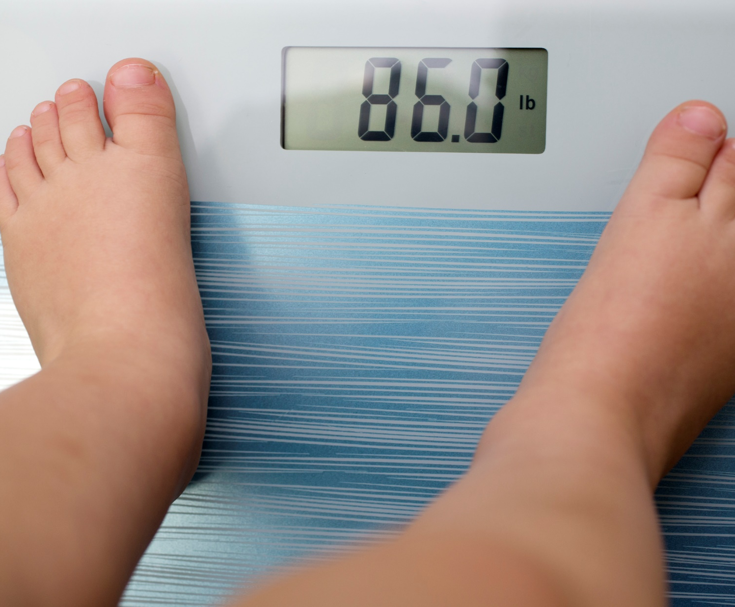
Childhood Obesity
55
© 2018 Ipsos MRBI
17-086507-Safetrak Research

Slide 56
Responsibility For Childhood Obesity – I (Unprompted)
ROI | NI
(507) | (301)
% | %
77 | 79
25 | 21
15 | 17
13 | 14
9 | 8
11 | 4
2 | 3
1 | -
1 | 1
- | 1
* | 1
3 | 3
2 | 5
Q.41 In your opinion, with whom or where, does the main responsibility for the current levels of childhood obesity lie?
Base: All Respondents: 808
Notes:
Parents of children aged 6mths to 12 even more likely to blame parents (81%)

Slide 57
Responsibility For Childhood Obesity – II (Unprompted)
ROI | NI
(189) | (83)
% | %
79 | 84
26 | 16
17 | 10
12 | 5
9 | 5
11 | 2
3 | 1
1 | -
1 | 2
- | 3
* | 1
1 | 3
3 | 2
Q.41 In your opinion, with whom or where, does the main responsibility for the current levels of childhood obesity lie?
Base: All parents of children aged 6 months-12 years: 272

Slide 58
Responsibility For Childhood Obesity – III (Unprompted)
ROI | NI
(272) | (113)
% | %
78 | 80
26 | 17
16 | 11
13 | 8
9 | 5
10 | 2
2 | 3
2 | -
1 | 2
- | 3
* | 2
3 | 3
3 | 2
Q.41 In your opinion, with whom or where, does the main responsibility for the current levels of childhood obesity lie?
Base: All parents of children under 18 living at home: 385

Slide 59
Tackling Childhood Obesity (Unprompted)
ROI | NI
(507) | (301)
% | %
13 | 12
13 | 9
11 | 8
6 | 10
8 | 5
3 | 12
6 | 6
5 | 5
4 | 6
Q.42 What one thing do you think should be done to tackle childhood obesity, or do you think nothing should be done?
Base: All Respondents: 808
* Others less than 5% of total not shown

Slide 60
Contacts
Aisling Corcoran
Director
Rebecca Porter
Associate Director
aisling.corcoran@ipsos.com
rebecca.porter@ipsos.com
+353 1 4389019
+ 353 1 4389041

